Slide 1


Challenges and Opportunities to The Use of Google Docs Sharing in Realtime Writing Task Feedback
ESL Inclusive Class at JMS

Slide 2





Presentation Outline
Background Information
Research Question
Research Method
Finding and Discussion
Future Plans
Definition of Research Context and Setting
Challenges and Opportunities (with and without ASD)
Subject and Setting, Data Collection and Analysis
Challenges and Opportunities (with and without ASD)
Actions taken after this research

Slide 3



Background Information
ESL Inclusive Classroom
Google Docs
Realtime Feedback
Consists of students from diverse nationalities (native language) and needs (ASD and Dyslexia)
Free web-based Microsoft Word offered by Google Corporation allows their users to create, edit and store their documents online
Given in a time when students working on their writing task
Notes:
Change the illustration

Slide 4

Research Questions?
What are the challenges in conducting the Google-Docs writing task for students with and without ASD?
What are the opportunities in conducting the Google-Docs writing task in ESL Inclusive classroom?

Slide 5





Research Method
Method
Subject and Setting
Qualitative Classroom Action Research
ESL Class Lower Secondary Level (Year 6 to 8)
Data Collection
Data Analysis
Subject and Research Setting, Data Collection and Data Analysis
Students’ writing task record, real-time feedback and interview
Through theory-based analysis

Slide 6
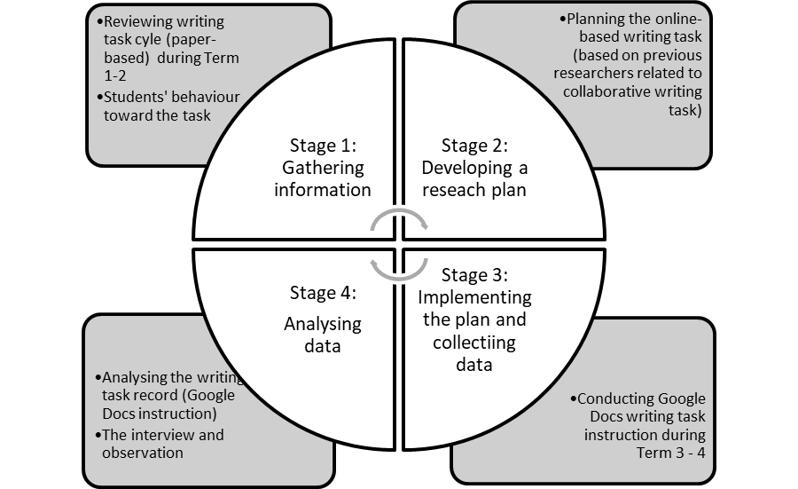
Research Outline and Timeline

Slide 7
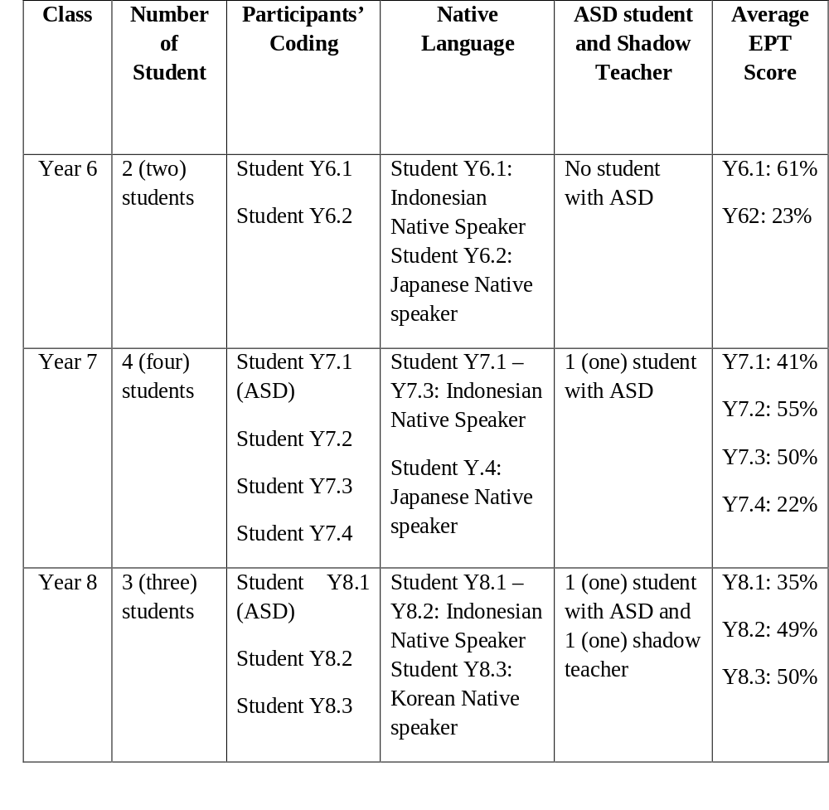
Participants’ Information

Slide 8

Finding and Discussion
This finding was focused on discussing the phenomenon on students with ASD, students without ASD that showed significant progress and students without ASD that showed less significant progress in writing task throughout the semester

Slide 9

Finding and Discussion
This finding was focused on discussing the phenomenon on students with ASD, students without ASD that showed significant progress and students without ASD that showed less significant progress in writing task throughout the semester

Slide 10
Students’ response to the writing task mode
Prefer to do the task with Google Docs
Prefer to do the task with paper
7 out of 9 participants
1 out of 9 participants
1 out of 9 participants
Suggested to have the paper-based writing
“It’s easier to type”
“I barely misspell a word”
“I can directly change what I need to change in my writing”
Prefer to do the paper-based writing task without real-time feedback
Based on his shadow teacher suggestion

Slide 11
Students’ opinion upon the lesson
I prefer Google Docs, because when we use Google Docs, we can get the feedback easily, so we don’t need to wait for next week and we can change it directly
I choose Google Docs, because I can directly edit my text.
“
”
“
”
Student Y7.1
in Google Docs I just need to type it and fix it, so it is easier and I don’t need to read it all
Student Y8.2
“
”
Student Y7.2

Slide 12
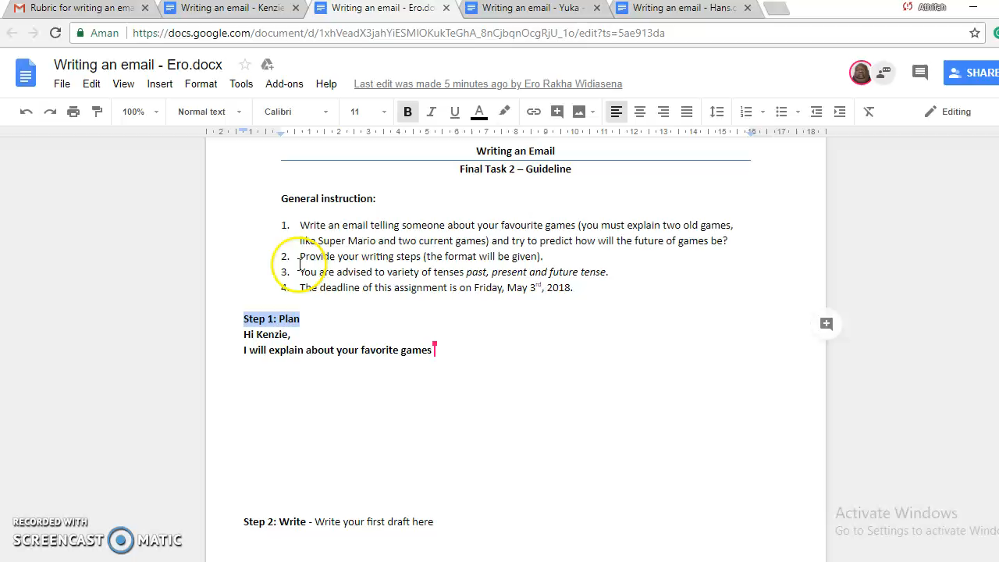
Realtime Feedback Recording
Writing Email – Year 7

Slide 13
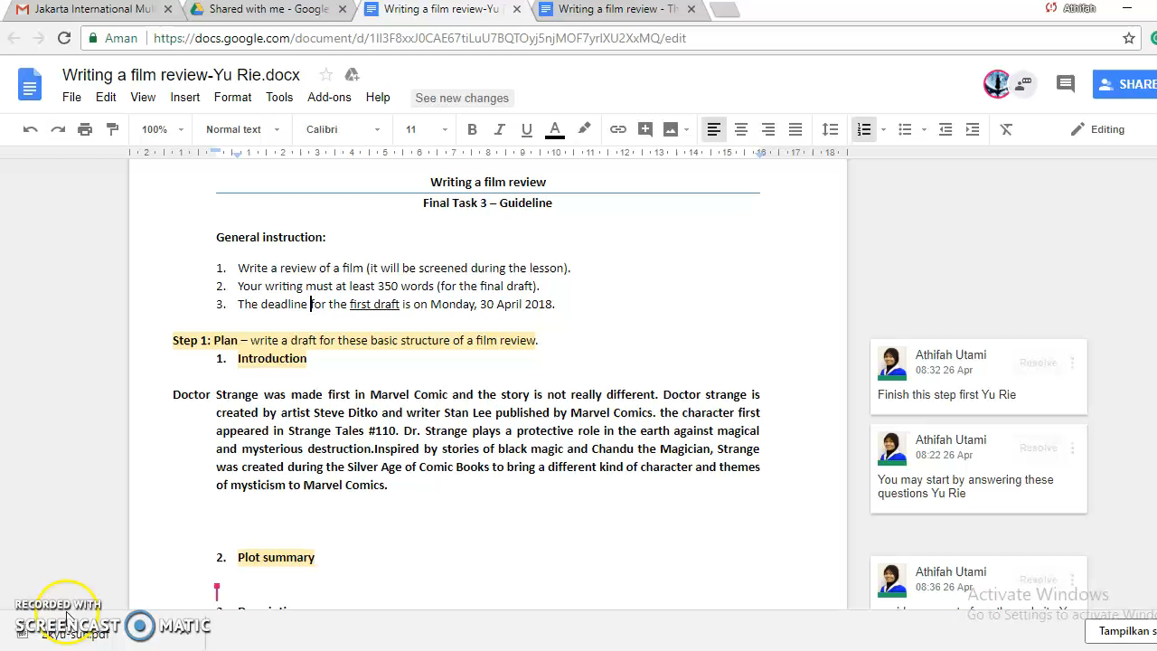
Realtime Feedback Recordin
Writing a film review – Year 8

Slide 14
Challenges to the Use of Google Docs Sharing for Realtime Writing Task Feedback in Inclusive ESL Classroom
Students with ASD
Students without ASD
The problem to stay focus when working with computer.
  I prefer for him to have handwriting task (paper-based task), because when he used Microsoft Word, it was hard for him to stay focus. He will busy opening a new tab or other things on computer, so it will take a longer time for him to finish the task. (Shadow teacher- Student Y8.1)
The need of extra supervision during the task.
The same problem in generating and elaborating ideas. (Less significant improvement)
  I think I confuse what should I write at that time, so I will forget the story, the things that I need to write. (Student Y6.1)
Based on the theory: The complex process of writing task might be challenging for students with ASD, since it involved the process of organizing ideas and presenting the message (Graham & Harris, 2005)

Slide 15
Opportunities to the Use of Google Docs Sharing for Realtime Writing Task Feedback in Inclusive ESL Classroom
Minimizing issues on ASD students’ handwriting
  The lower quality of handwriting: neatness of a written product tends to impact a teacher’s rating of a writing sample. Specifically, illegible papers tend to score lower than those of equal quality that are written neatly (Graham, Harris, & Hebert, 2011).
The efficiency of time to finish the writing task cycle
  Paper-based writing task time consuming compare to Google-Docs writing task
Increase students’ motivation
  Students prefer to do some writing task (depend on the text genre)

Slide 16
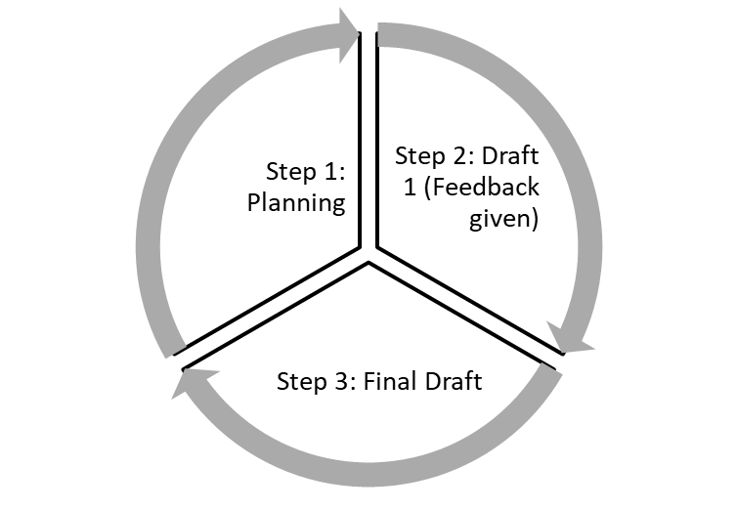
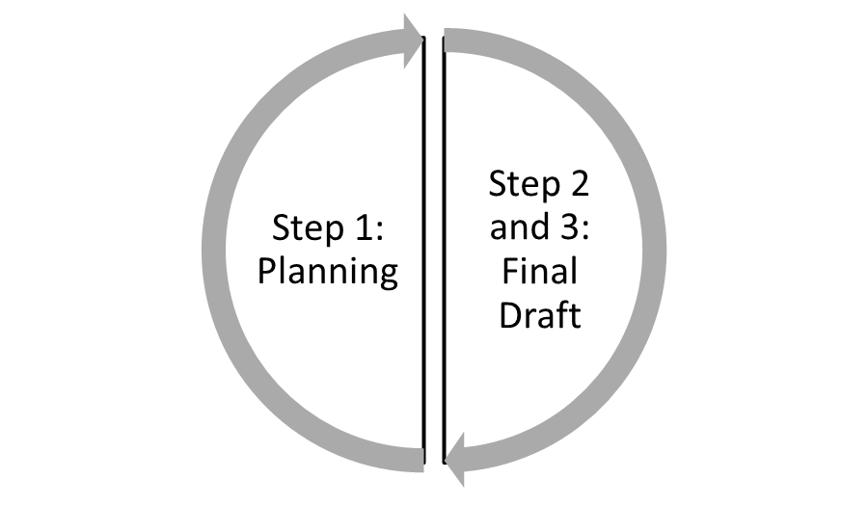
The efficiency of time to finish the writing task cycle
Paper-based writing task
Take one to two weeks to finish the whole process
Google-Docs writing task
Take one week to finish the whole process

Slide 17
Increase students’ motivation
Non-fiction (informative) writing
Requires them to do research – find some facts
Fiction text (narrative) writing
It doesn’t require them to do research before
Requires them to put a graphic illustration or photo
Requires them to interact / share their writing with their peers
Requires them to do a role-play

Slide 18

Summary
Challenges:
  Student with ASD: hardly to stay focus and need extra supervision.
  Student without ASD: hardly to elaborate the ideas.
Opportunities:
  Time efficiency
  Minimize the student’s handwriting issues
  Increase students’ motivation

Slide 19




Thank You
Asian Conference on Education
Athifah Utami
+6285774658832
athifah.utami@Jimsch.org

